Slide 1
12/2/22

Slide 2
6.4: Array Algorithms
part 1

Slide 3
Common Array Algorithms (bold ones today, others Monday)
Here are some common algorithms that you should be familiar with for the AP CS A exam:
Determine the minimum or maximum value in an array
Compute a sum, average, or mode of array elements
Search for a particular element in the array
Determine if at least one element has a particular property
Determine if all elements have a particular property
Access all consecutive pairs of elements
Determine the presence or absence of duplicate elements
Determine the number of elements meeting specific criteria
Shift or rotate elements left or right
Reverse the order of the elements
An exam FRQ will not be just one of these! It'll be some variation or combination... but you still need to know all of these!

Slide 4
Minimum and Maximum Value
These require a "tracking value" for the smallest or largest value found so far.
25 | 70 | 9 | 3 | 15 | 16 | 19
minV =
25
25
9
3
3
3
3

Slide 5
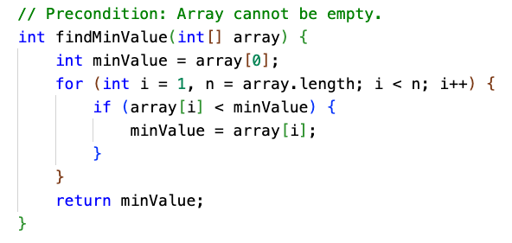
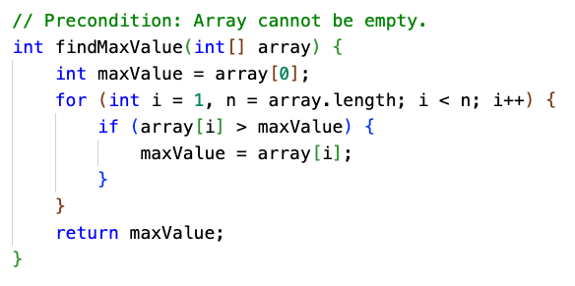
Minimum and Maximum Value
One trick is to "seed" the tracking value with the first element, and skip it in the loop.

Slide 6
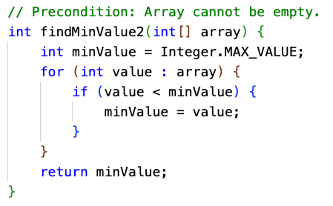
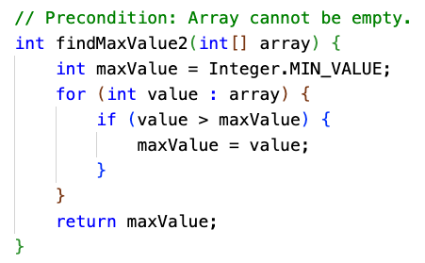
Minimum and Maximum Value
Another way is to use the minimum/maximum value of the data type... careful which! Or, you could use the first element here, too, and just scan it twice.

Slide 7
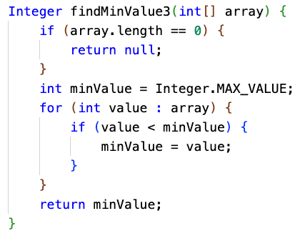
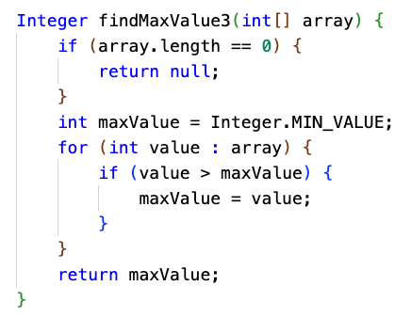
Minimum and Maximum Value
You could get rid of the precondition by returning Integer. But now callers must deal with the possibility of a null being returned.

Slide 8
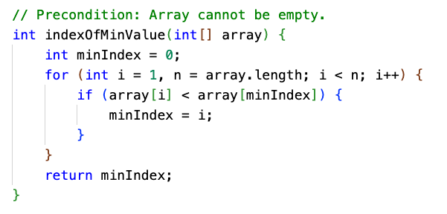
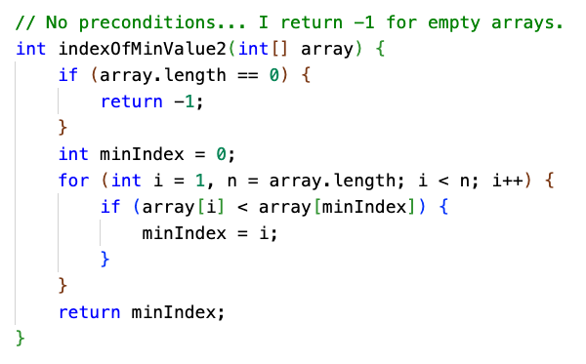
Minimum and Maximum Value
With a little modification, you could return the array index instead of the value.

Slide 9
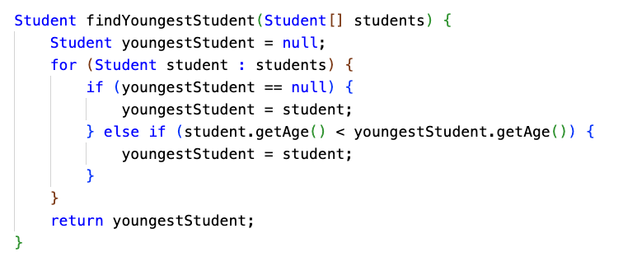
Minimum and Maximum Value of Objects
You might be dealing with an array of something other than numbers.

Slide 10
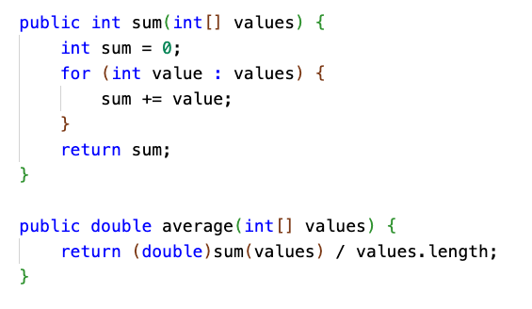
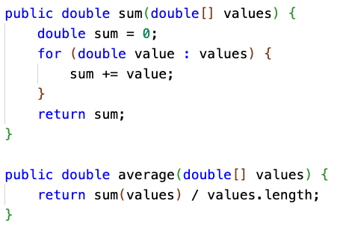
Sum and Average
If dealing with ints, remember to cast to double when calculating average. (Also known as the arithmetic mean.)

Slide 11
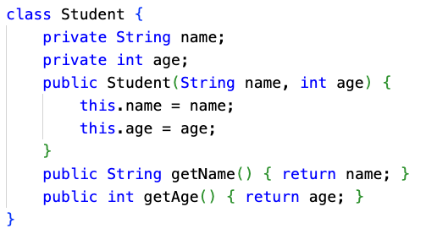
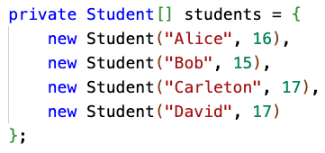
Calculations aren't always over int[] or double[]...
What if you are calculating the average age of a class of Students?

Slide 12
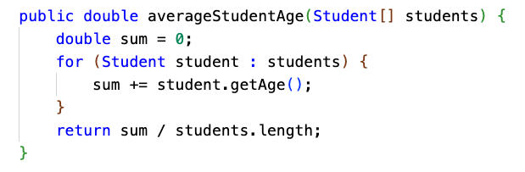
Calculations aren't always over int[] or double[]...
What if you are calculating the average age of a class of Students?

Slide 13
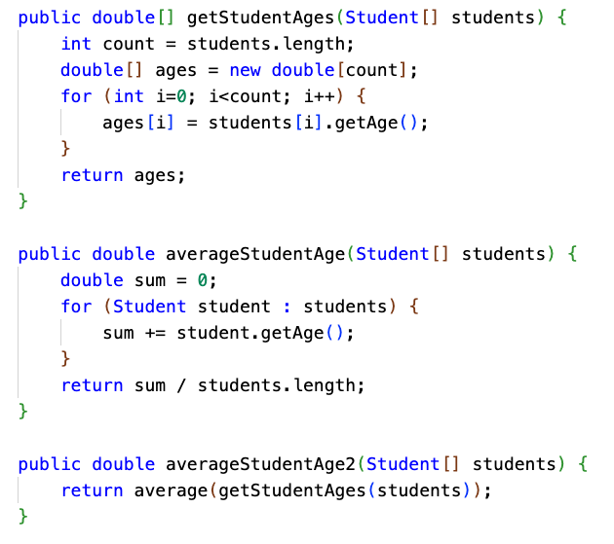
Transforming arrays to do calculations
It can make sense to transform an Array into another Array, and then do a calculation.
Creating the ages Array takes time and memory... but it can make sense, depending on the situation.
The age data might be used more than once
You might be interfacing with code, such as a third-party library, that doesn't know about Students
Your math-heavy code stays in its "domain" ... it only needs to know about math, not Students, and can be reused for things other than Students.
Performance and memory usage may not be critical

Slide 14
Median
Median is defined as the "middle element" of an array.
The array needs to be sorted for it to work.
If the array has odd length, the element in the middle is returned.
If the array is of even length, there isn't a "middle" ... so return the mathematical average of the two elements in the middle.
1 | 3 | 7 | 9 | 15 | 16 | 19
1 | 3 | 7 | 9 | 15 | 16 | 19 | 23

Slide 15
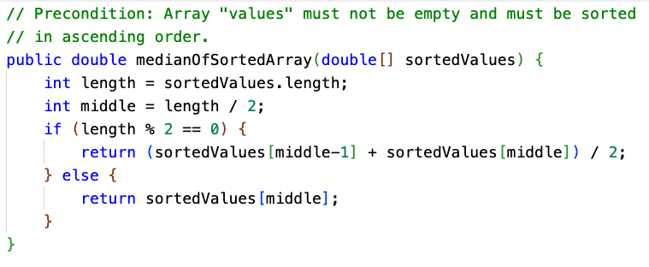
Median
The array needs to be sorted. We could declare a precondition!
We also declare a precondition that the input array must not be empty.

Slide 16
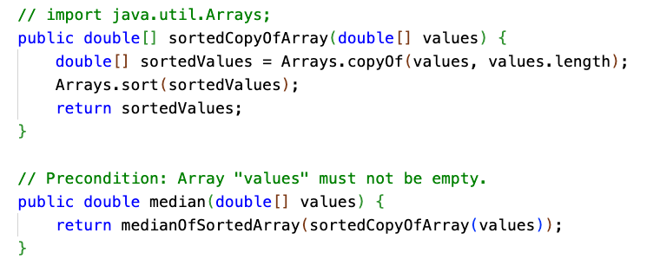
Median
We could sort the array on behalf of the caller. However, we shouldn't sort the array they passed to us by reference... that would be an unwanted side effect.

Slide 17

Median Student Age
Suppose we have an array of Students again. How do we calculate the median age?
We're able to use the tools we already built to get the student ages, and calculate the median of an array of numbers.
This is the power of composing methods together, and having general-purpose methods that can be applied in multiple situations. Breaking big problems into smaller problems is what CS is all about.

Slide 18
Mode
The mode of an array is the value that occurs most frequently.
What is the mode of this array?
17 | 17 | 9 | 9 | 9 | 9 | 1 | 17 | 19 | 3 | 3 | 5

Slide 19
Mode
We can calculate the mode using a nested loop. For each element, count the number of occurrences of that element, and track which element has the maximum number of occurrences.
17 | 17 | 9 | 9 | 9 | 9 | 1 | 17 | 19 | 3 | 3 | 5
frequency (of value at current index)
3 | skip | 4 | skip | skip | skip | 1 | 3 | 1 | 2 | skip | 1
modeValue
17 | 17 | 9 | 9 | 9 | 9 | 9 | 9 | 9 | 9 | 9 | 9
modeFrequency
3 | 3 | 4 | 4 | 4 | 4 | 4 | 4 | 4 | 4 | 4 | 4

Slide 20
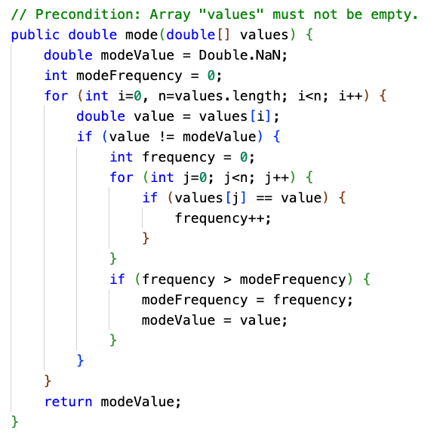
Mode
The running time of this algorithm is O(N²).
Good? Bad?

Slide 21
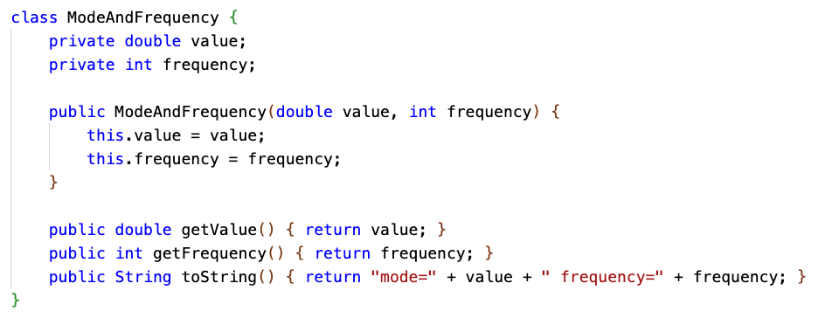
ModeAndFrequency
What if the caller wants to know both the mode value and the frequency? How do we return both values? Package it in a class.

Slide 22
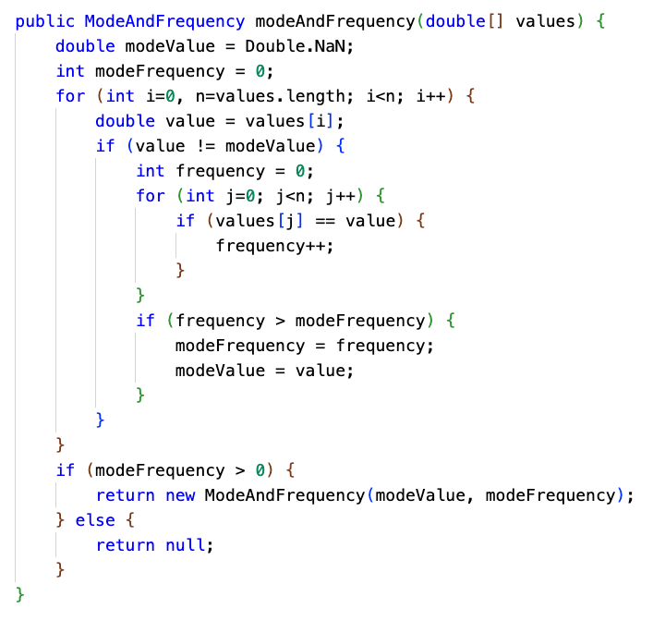
ModeAndFrequency
Now we also can return null to signify that the array is empty.

Slide 23
Mode
What if the array is sorted? Does that make it easier to calculate the mode?
1 | 1 | 2 | 2 | 2 | 3 | 3 | 3 | 3 | 4 | 4 | 5

Slide 24
Mode of sorted array
With a sorted array, all of the repeated elements are adjacent to each other.
We can avoid a nested loop.
We just need to loop once, and count how many occurrences there are of each element.
We still need to track the maximum frequency, and the value associated with it.
1 | 1 | 2 | 2 | 2 | 3 | 3 | 3 | 3 | 4 | 4 | 5

Slide 25
Mode of sorted array
This algorithm is a form of access all consecutive array elements.
We compare each element to the previous one to see how long the "runs" are.
1 | 1 | 2 | 2 | 2 | 3 | 3 | 3 | 3 | 4 | 4 | 5
frequency
1 | 2 | 1 | 2 | 3 | 1 | 2 | 3 | 4 | 1 | 2 | 1
modeValue
1 | 1 | 1 | 1 | 2 | 2 | 2 | 2 | 3 | 3 | 3 | 3
modeFrequency
1 | 2 | 2 | 2 | 3 | 3 | 3 | 3 | 4 | 4 | 4 | 4

Slide 26
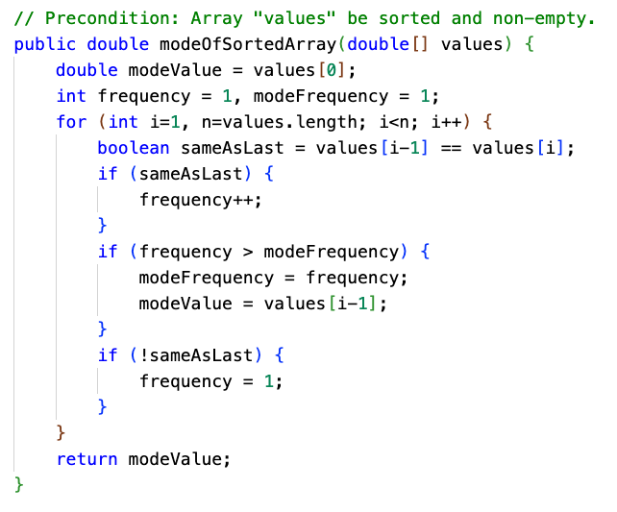
Mode of sorted array
Note how like calculating the minimum or maximum value, we can:
Seed the tracking variables with the first element in the array
And then, skip that element when iterating by starting the loop at i=1.
The running time of this algorithm is O(N).
But... the array must be sorted, and sorting takes O(N•log(N)).

Slide 27
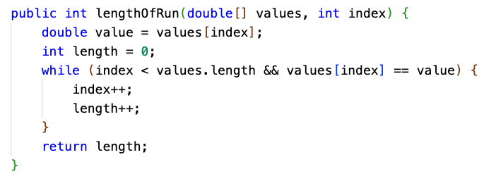
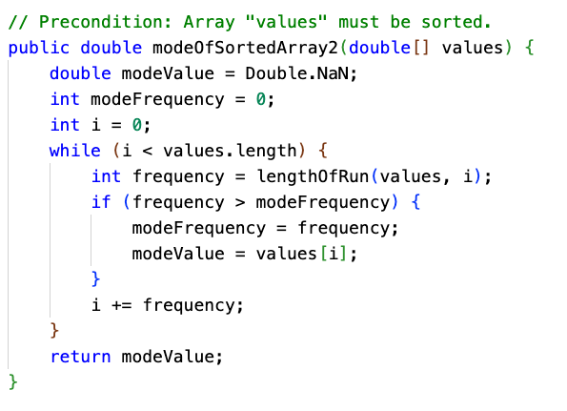
Mode of sorted array
This code is a bit easier to understand than the last slide, no? It helped to break the problem up into two problems.

